Slide 1
CONSTANd & QCQUAN
Dirk Valkenborg

Slide 2
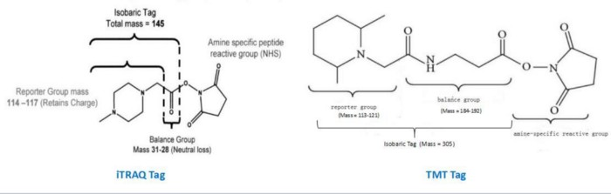
Isobaric labels
It is about multiplexing samples, saving instrument time, and having quantitative measurements that are affected by the same amount of variability.

Slide 3
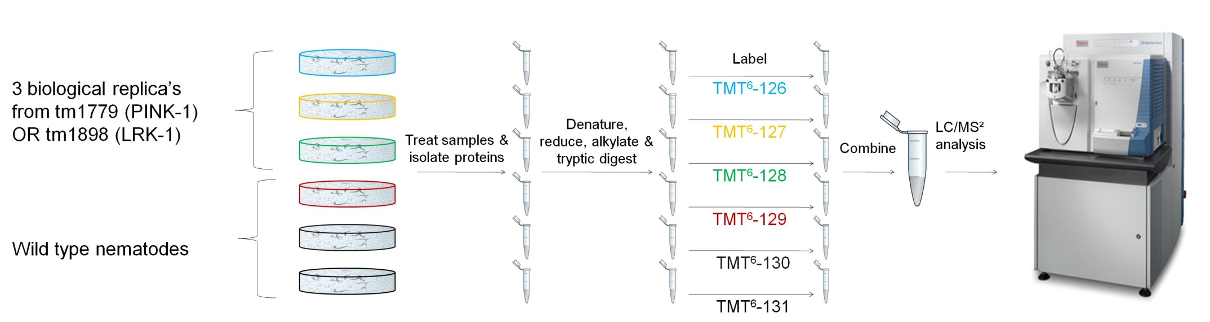
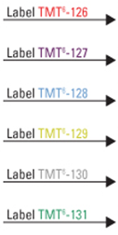
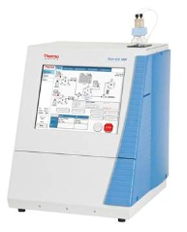
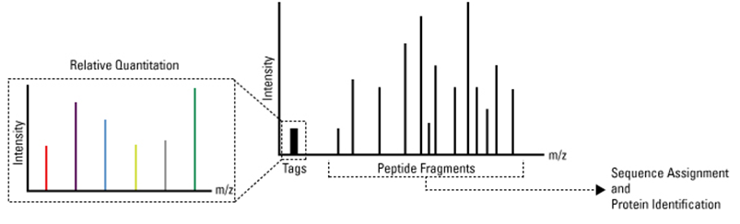
Isobaric labeling & systematic errors
Starting material = 10 µg protein extract (BCATM protein assay) used for labeling
Design of Experiment
2D-LCMS
Demultiplexing
Source: Adapted from www.piercenet.com

Slide 4




Slide 5



Quantification channels

Slide 6

Normalization
“A transformation of the data to remove any systematic non-biological variation and to balance them appropriately so that meaningful biological comparisons can be made”
Nat Genet. 2002;32 Suppl:496-501.
Microarray data normalization and transformation.
Quackenbush J.

Slide 7

We need Statisticians and bioinformaticians to Handle this data flood!!

Slide 8
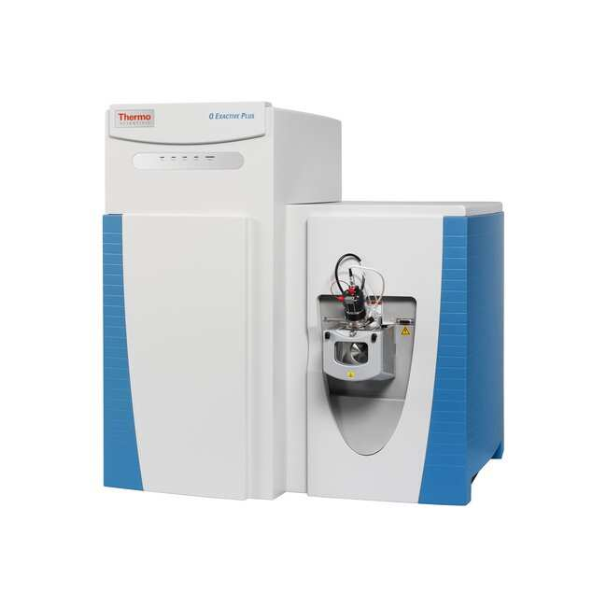
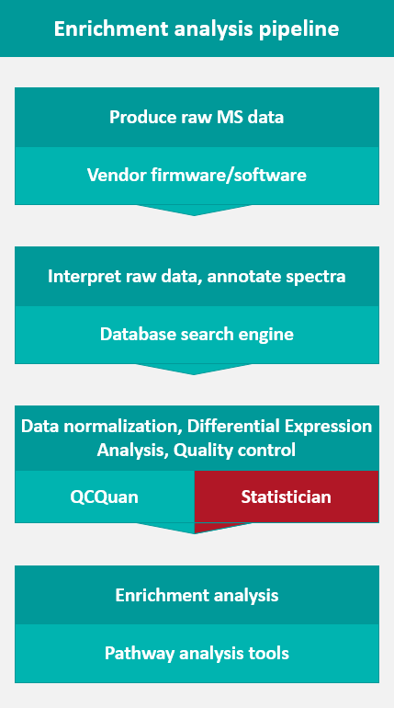




A bottleneck arises!!!!!
A Web Tool for the Automated Assessment of Protein Expression and Data Quality of Labeled Mass Spectrometry Experiments

Slide 9

Isobaric labeling and its effect on data
Natural batch effect because we multiplex 6 samples into one mass spectrometry analysis
Errors at several stages of the sample handling and sample mixing

Slide 10
The CONSTANd method
Data-driven normalization
Three conditions have to be fulfilled (MA-scatter plot):
the majority of proteins/peptides do not vary between samples.
the number of up-regulated ≈ the number of down-regulated.
the systematic bias is proportional over the intensity.
$$M=\log_{2}{\frac{I_{tmt1}}{I_{tmt2}}}$$
$$A= \frac{1}{2}\left(\log_{10}{I_{tmt1}}+\log_{10}{I_{tmt2}}\right)$$
Reference set = all identified peptides.
No pull-downs!
Assume shift is not from biology.
To avoid bias in the estimate of the central tendency in the data.
Trend has to be constant.

Slide 11
Data representation
Reporter channels: j = 1 … n
 | ch1 | ch2 | ch3 | … | … | n
pep1 | a₁₁ | a₁₂ | a₁₃ |  |  | a_{1n}
pep2 | a₂₁ | a₂₂ | a₂₃ |  |  | a_{2n}
pep3 | a₃₁ | a₃₂ | a₃₃ |  |  | a_{3n}
pep4 | a₄₁ | a₄₂ | a₄₃ |  |  | a_{4n}
…
…
m | a_{m1} | a_{m2} | a_{m3} |  |  | a_{mn}
sum = 1
Peptides:
i = 1 … m
BMC Genomics. 2005;6:145.
i-Tracker: for quantitative proteomics using iTRAQ.
Shadforth IP, Dunkley TP, Lilley KS, Bessant C.

Slide 12
A different boxplot
percentage

Slide 13

Constrained standardization (CONSTANd)
Reporter channels: j = 1 … n
 | ch1 | ch2 | ch3 | … | … | n
pep1 | a₁₁ | a₁₂ | a₁₃ |  |  | a_{1n}
pep2 | a₂₁ | a₂₂ | a₂₃ |  |  | a_{2n}
pep3 | a₃₁ | a₃₂ | a₃₃ |  |  | a_{3n}
pep4 | a₄₁ | a₄₂ | a₄₃ |  |  | a_{4n}
…
…
m | a_{m1} | a_{m2} | a_{m3} |  |  | a_{mn}
$$\sum_{j=1}^{n}{a_{2j}}=1$$
Peptides:
i = 1 … m
$$\sum_{i=1}^{m}{a_{i1}}=m ×\frac{1}{n}$$
∝ protein concentration →

Slide 14
The mathematical formulation
Reporter channels: j = 1 … n
 | ch1 | ch2 | ch3 | … | … | n
pep1 | a₁₁ | a₁₂ | a₁₃ |  |  | a_{1n}
pep2 | a₂₁ | a₂₂ | a₂₃ |  |  | a_{2n}
pep3 | a₃₁ | a₃₂ | a₃₃ |  |  | a_{3n}
pep4 | a₄₁ | a₄₂ | a₄₃ |  |  | a_{4n}
…
…
m | a_{m1} | a_{m2} | a_{m3} |  |  | a_{mn}
$$\frac{1}{n}\sum_{j=1}^{n}{a_{2j}}=\frac{1}{n}$$
Peptides:
i = 1 … m
$$\frac{1}{m}\sum_{i=1}^{m}{a_{i1}}=\frac{1}{n}$$

Slide 15

Missing observations
Reporter channels: j = 1 … n
 | ch1 | ch2 | ch3 | … | … | n
pep1 | a₁₁ | a₁₂ | a₁₃ |  |  | a_{1n}
pep2 |  | a₂₂ | a₂₃ |  |  | a_{2n}
pep3 | a₃₁ | a₃₂ | a₃₃ |  |  | a_{3n}
pep4 | a₄₁ | a₄₂ | a₄₃ |  |  | a_{4n}
…
…
m | a_{m1} | a_{m2} | a_{m3} |  |  | a_{mn}
$$\frac{1}{n−1}\sum_{j=2}^{n}{a_{2j}}=\frac{1}{n}$$
Peptides:
i = 1 … m
$$\sum_{j=2}^{n}{a_{2j}}=\frac{n−1}{n}$$
$$\frac{1}{m−1}\sum_{i=2}^{m}{a_{i1}}=\frac{1}{n}$$

Slide 16
An optimization problem
The problem is to find a ‘new’ matrix K that deviates least from the original data in A whilst subjected to equality constraints
 | ch1 | ch2 | ch3 | … | … | n
pep1 | a₁₁ | a₁₂ | a₁₃ |  |  | a_{1n}
pep2 | a₂₁ | a₂₂ | a₂₃ |  |  | a_{2n}
pep3 | a₃₁ | a₃₂ | a₃₃ |  |  | a_{3n}
pep4 | a₄₁ | a₄₂ | a₄₃ |  |  | a_{4n}
…
…
m | a_{m1} | a_{m2} | a_{m3} |  |  | a_{mn}
Mean*(row_{i})$=\frac{1}{n}$
$$\begin{aligned}\min_{x}{f\left(x\right)} \\ s.t. g\left(x\right)=0\end{aligned}{ }$$
Mean*(column_{j})$=\frac{1}{n}$
*on the observed values

Slide 17

The RAS procedure or Matrix Raking
RAS is a special case of the Iterative Proportional Fitting Procedure (IPFP) and originates from econometrics. Invented by Sir John Richard Nicholas Stone.
S
m+n degrees of freedom
S₁ | S₂ | S₃ | … | … | S_{n}
R₁
R₂
R₃
R₄
…
…
R_{m}
a₁₁ | a₁₂ | a₁₃ |  |  | a_{1n}
a₂₁ | a₂₂ | a₂₃ |  |  | a_{2n}
a₃₁ | a₃₂ | a₃₃ |  |  | a_{3n}
a₄₁ | a₄₂ | a₄₃ |  |  | a_{4n}
a_{m1} | a_{m2} | a_{m3} | a_{m4} | a_{m5} | a_{mn}
A linear transformation
K$= \hat{R}×A×\hat{S}$
R
Where $\hat{S}$ and $\hat{R}$ are diagonal matrices of S and R.
Cambridge University Press 1970.
Biproportional matrices and input-output change.
Bacharach, M.
Annals of Mathematical Statistics 1970; 41(3): 907–917.
An Iterative Procedure for Estimation in Contingency Tables.
Fienberg, S. E.

Slide 18
The RAS algorithm
K = data (A)
while (not converged)
%calculate scale factor
R = 1./m .* 1./mean*_{row}(K)
%balancing the rows
K = diag(R) * K
%calculate normalization factor
S = 1./m .* 1./mean*_{column}(S)
%balancing the columns
K = K * diag(S)
end
*on the observed values

Slide 19
Results
6 mice with orthotopic non-small cell lung adenocarcinomas
Isolation of tumor-associated macrophages → TAMs
Isolation of peritoneal macrophages (in-vivo control) → PMs
Stimulate bone marrow to produce macrophages (in-vitro control) → BMs
18 samples → digest → Labeling → 2D-LC-MS/MS
Processing in PD2.0 → Keep non-redundant peptides from Mascot/Sequest @ 5% FDR based on reversed TDA → 4357 x 18 (971 x 18)
ID/label | TMT⁶-126 | TMT⁶-127 | TMT⁶-128 | TMT⁶-129 | TMT⁶-130 | TMT⁶-131
tmt1 | BM3 | PM3 | TAM4 | BM4 | TAM3 | PM4
tmt2 | PM5 | TAM6 | BM5 | TAM5 | PM6 | BM6
tmt3 | TAM1 | BM1 | PM1 | PM2 | BM2 | TAM2

Slide 20
RESULTS
CONSTANd

Slide 21
HEATMAP
Quantile normalisation

Slide 22
HEATMAP
CONSTANd

Slide 23
PCA-plots
Quantile normalisation
CONSTANd

Slide 24
MA-plots
Quantile normalisation
Intra-experimental (BM3 vs BM4)
Inter-experimental (BM3 vs BM5)

Slide 25
MA-plots
CONSTANd
Intra-experimental (BM3 vs BM4)
Inter-experimental (BM3 vs BM5)

Slide 26
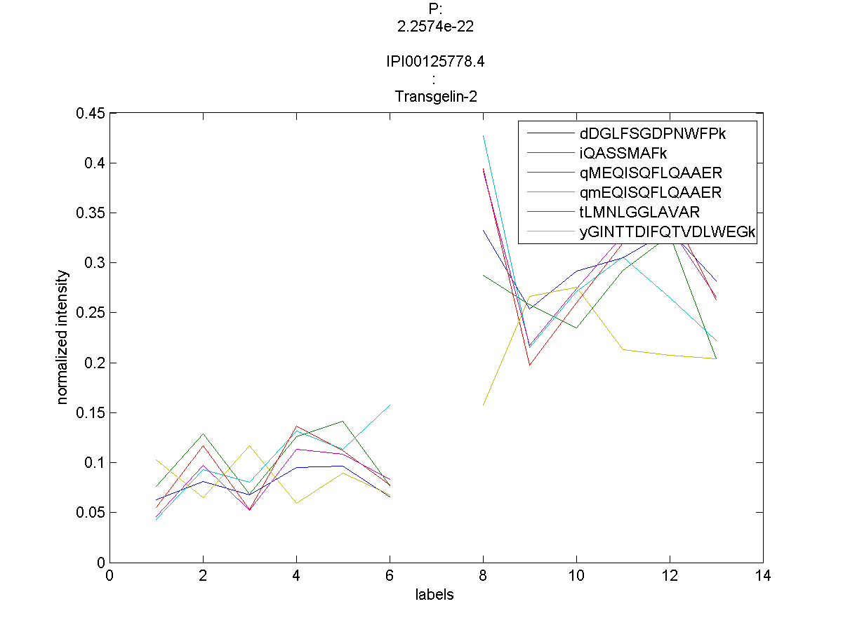
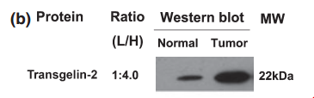
ConveniEnt downstream analysis
List of proteins confidently identified in the experiments
For each condition query the peptides that belong to the protein over the multiple experiments
Treat the peptide intensities as different observations and perform t-test or ANOVA
Use clustering to remove non-unique peptides or gather more from the unidentified tandem MS data.
Zhang et al. Cancer Sci, 101:2, 523–529,2010

Slide 27
A word on convergence
Exponential or log-linear convergence
Converges asymptotically to the maximum likelihood estimator
Estimates presumably unbiased under missing-at-random assumption.
Convergence after 1 µsec

Slide 28
Concluding remarks
Data normalization framed as a constrained optimization problem
Constraints originate from understanding about the experimental procedure.
Constraints are compatible with the RAS procedure and converges to a unique and exact solution.
Provides unbiased estimates under the missing-at-random model.
Intra-experimental normalization is valid for inter-experimental comparison because of the normalized percentage interpretation.
No need for reference labels – so optimal use of the isobaric tags in multiple experimental designs.

Slide 29
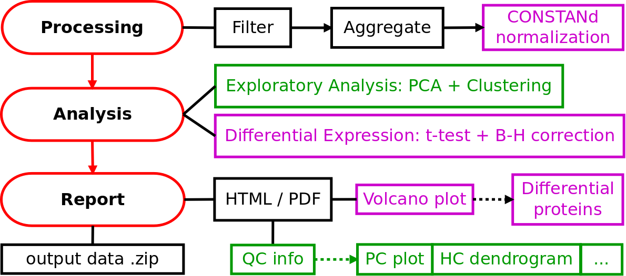
QCQUAN relies on CONSTANd to facilitate a downstream analysis
doi: 10.1074/mcp.M115.056911
Moderated t-test + BH
doi: 10.1016/j.euprot.2015.02.002

Slide 30

QCQuan
https://qcquan.net/

Slide 31

QCQuan

Slide 32

QC & Quan made as simple as …
1) Proteome discoverer analysis
export as tsv-files
2) Upload to QCQuan
3) Inspect the results
report
iPathwayGuide
experimental design
no user params
results .tsv
doi: 10.1021/acs.jproteome.9b00072

Slide 33
USERS?
For those who want to do a fast, intermediate, and elementary statistical analysis for multi-run LC-MS experiments;
Provides immediate feedback that can be used for data triaging and relegate low-quality experiments to the trash bin.
Editors who want to verify whether statistics are performed well.
Often hard to understand what exactly is done.
QCQuan is reproducible, and versioned, and you cannot tweak any user-defined parameters.
Quality report associated with the data.

Slide 34

A critical reflection
What do people mean when they talk about normalization?
Equalize intensity box plots across the multiplexed samples
Standardize the intensity distribution of a protein
Transform the intensities such that the variance is stabilized or data looks more normally distributed.
CONSTANd

Slide 35
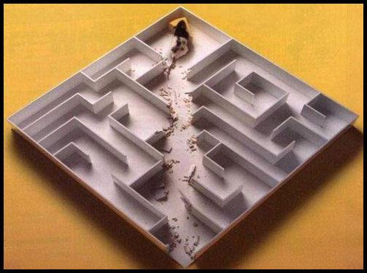
Thanks for your attention!

Slide 36

Questions?

